Slide 1

CPSC-597A-AB VoteSphere: Kubernetes-Enabled Voting Platform
Professor
Ausif Mohmood
Team Members
Vivek Gullapalli, 1166039
Srikanth Ravuri, 1166104
Yeswanth Sai Anne, 1173701

Slide 2
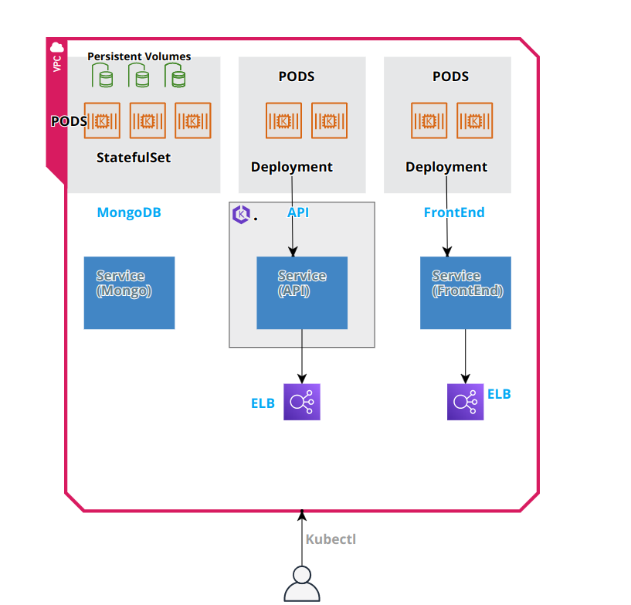
Architecture
Database: Ebs volumes->3 pods
API:Deployments->2 pods,load balancer
Frontend:Deployments->2 pods, LoadBalancer

Slide 3
Resources used
Elastic Kubernetes services
EC2 instance
LoadBalancer types
IAM users

Slide 4
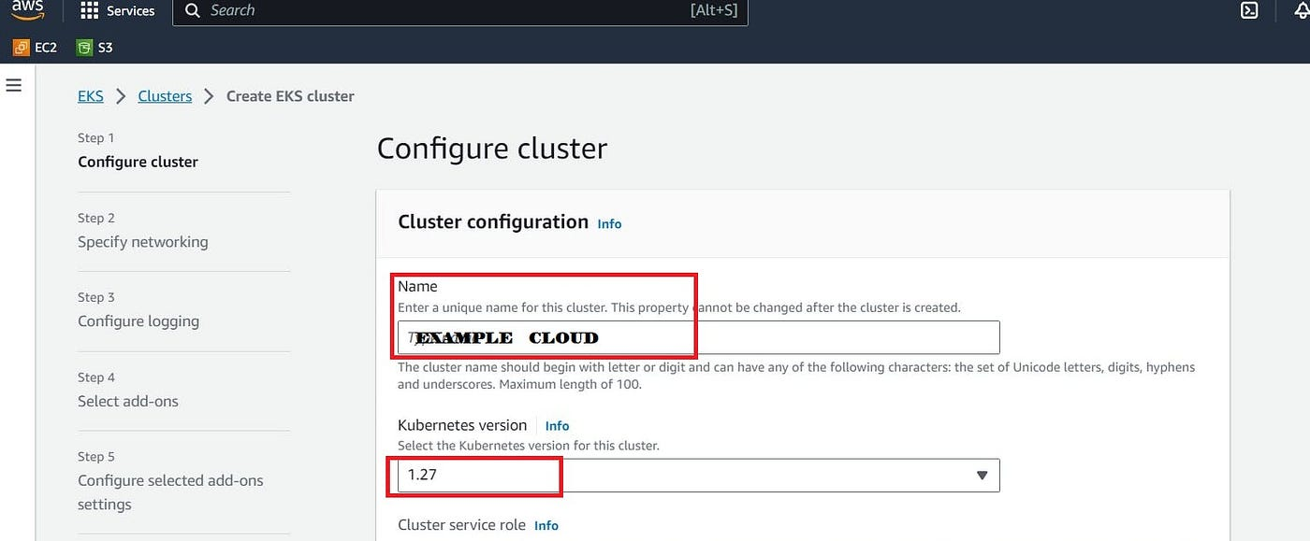
Elastic kubernetes
Create a new cluster as Cluster-1 as using myAmazonEKSClusterRole policy
Set default vpc
Add ebs csi addons for creating posession volumes
In compute section we need to create node groups

Slide 5
EC2
Create an instance as project server and using key pair as Uswest
Create a role EKSaccess and assign to the instance
In EKSaccess role add json cluster group policies and amazonEBS policies
After Creating Instance we will create Kubectl to manage Kuberenetes Cluster
Need to install AWS CLI t manage AWS services
Now Clone the Repository

Slide 6
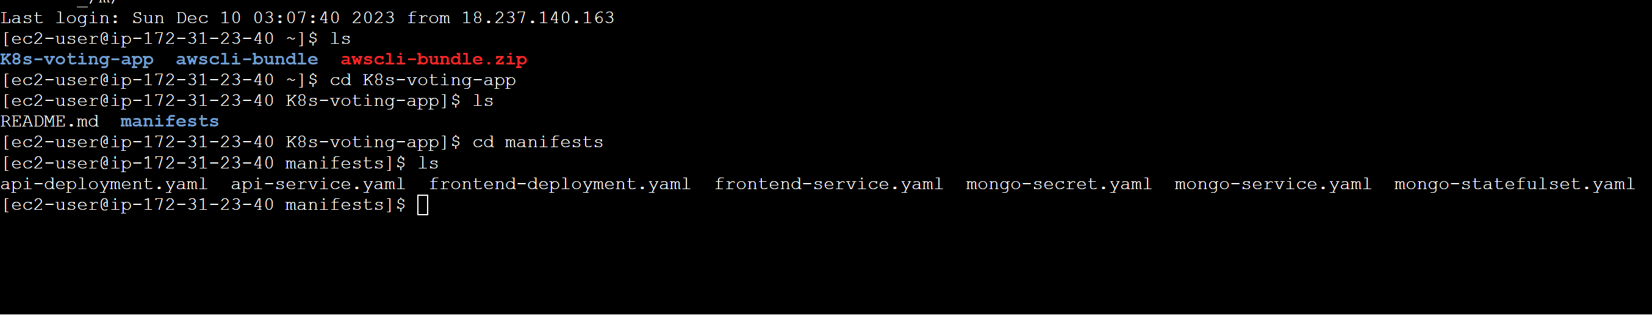
Repository overview

Slide 7
In EKS create node group with myAmazonEKSRole
Now we need to set a context in EC2 instance
aws eks update-kubeconfig --name EKS_CLUSTER_NAME --region us-west-2
But from our instance using EKSaccess role we can’t get the pods because we are accessing the pods from the Cluster creater to get the access we need to add on config map with arn value

Slide 8
Database deployment
From the repository create name space of stateful set
Now apply the manifest file in the name space which creates three volumes
In the three volume sets one is primary and the other two are replica for backup
Now the three pods are ready
Now create a service from yaml file to expose the api

Slide 9
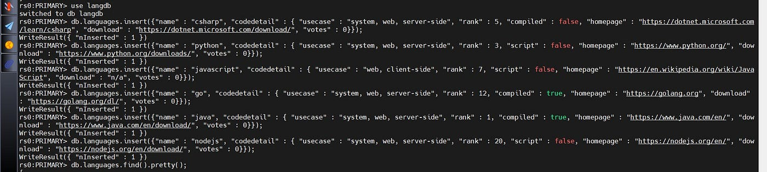
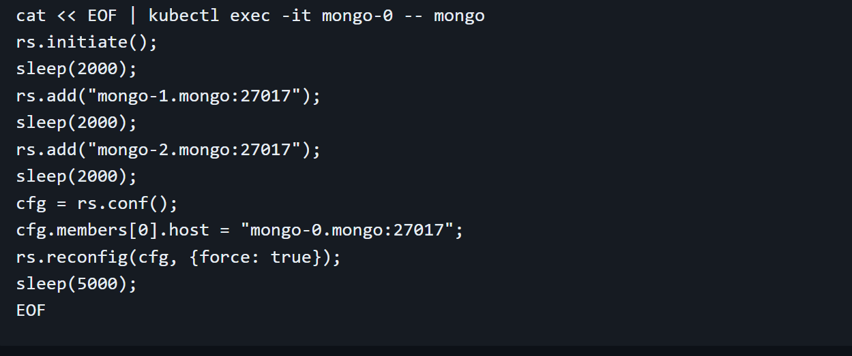
Setting mongo zero as primary and the remaining two pods as replica sets
Now create database in mongodb using command use langdmb():
Now insert the data in mongo zero pod

Slide 10
Api deployment
Create secret for database
Where the user is admin in base 64 format
By deployment.yaml we will create 2 pods
From api service.yaml file while creating service it will create a Load Balancer

Slide 11
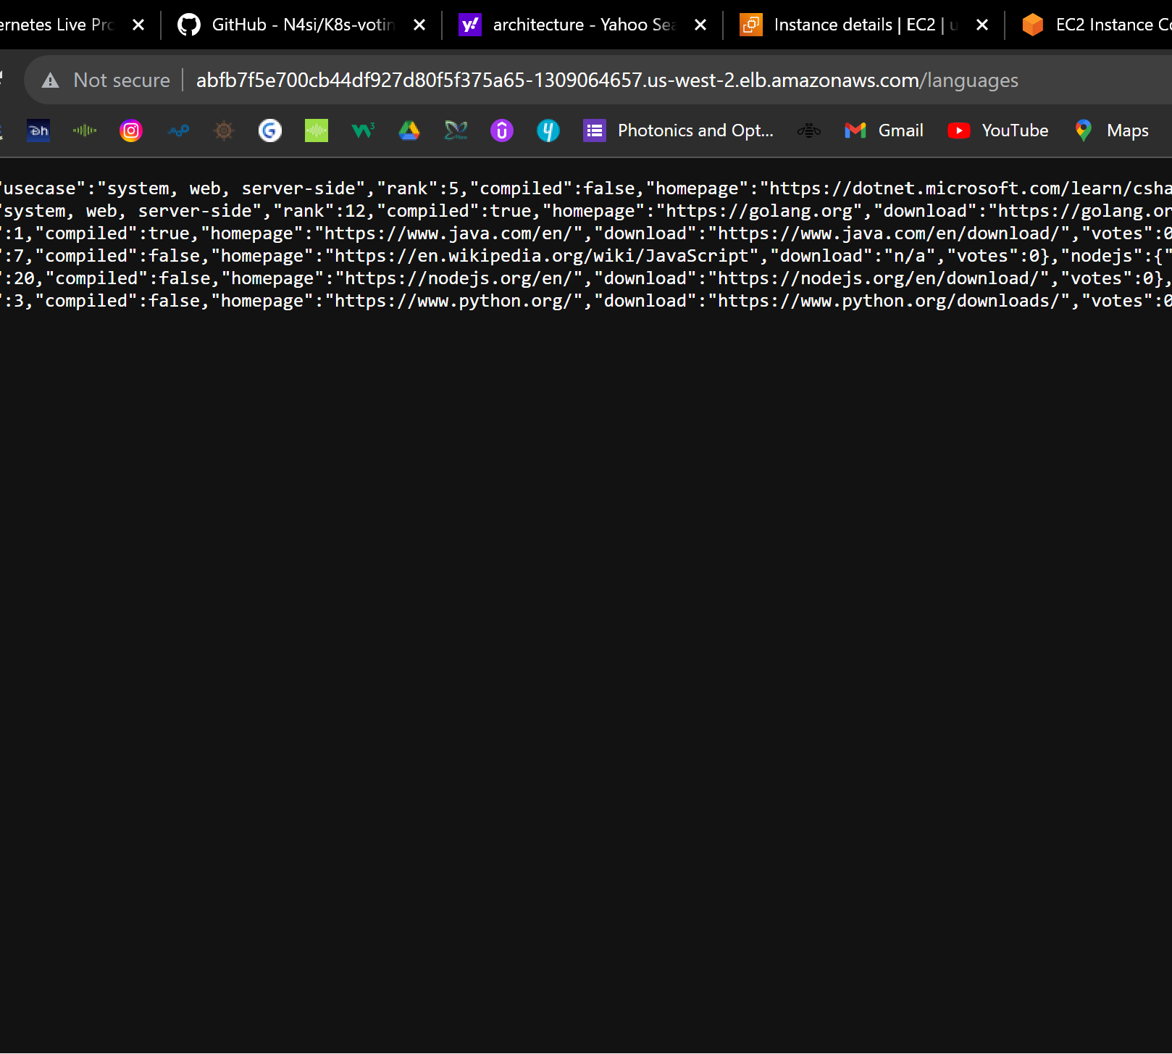
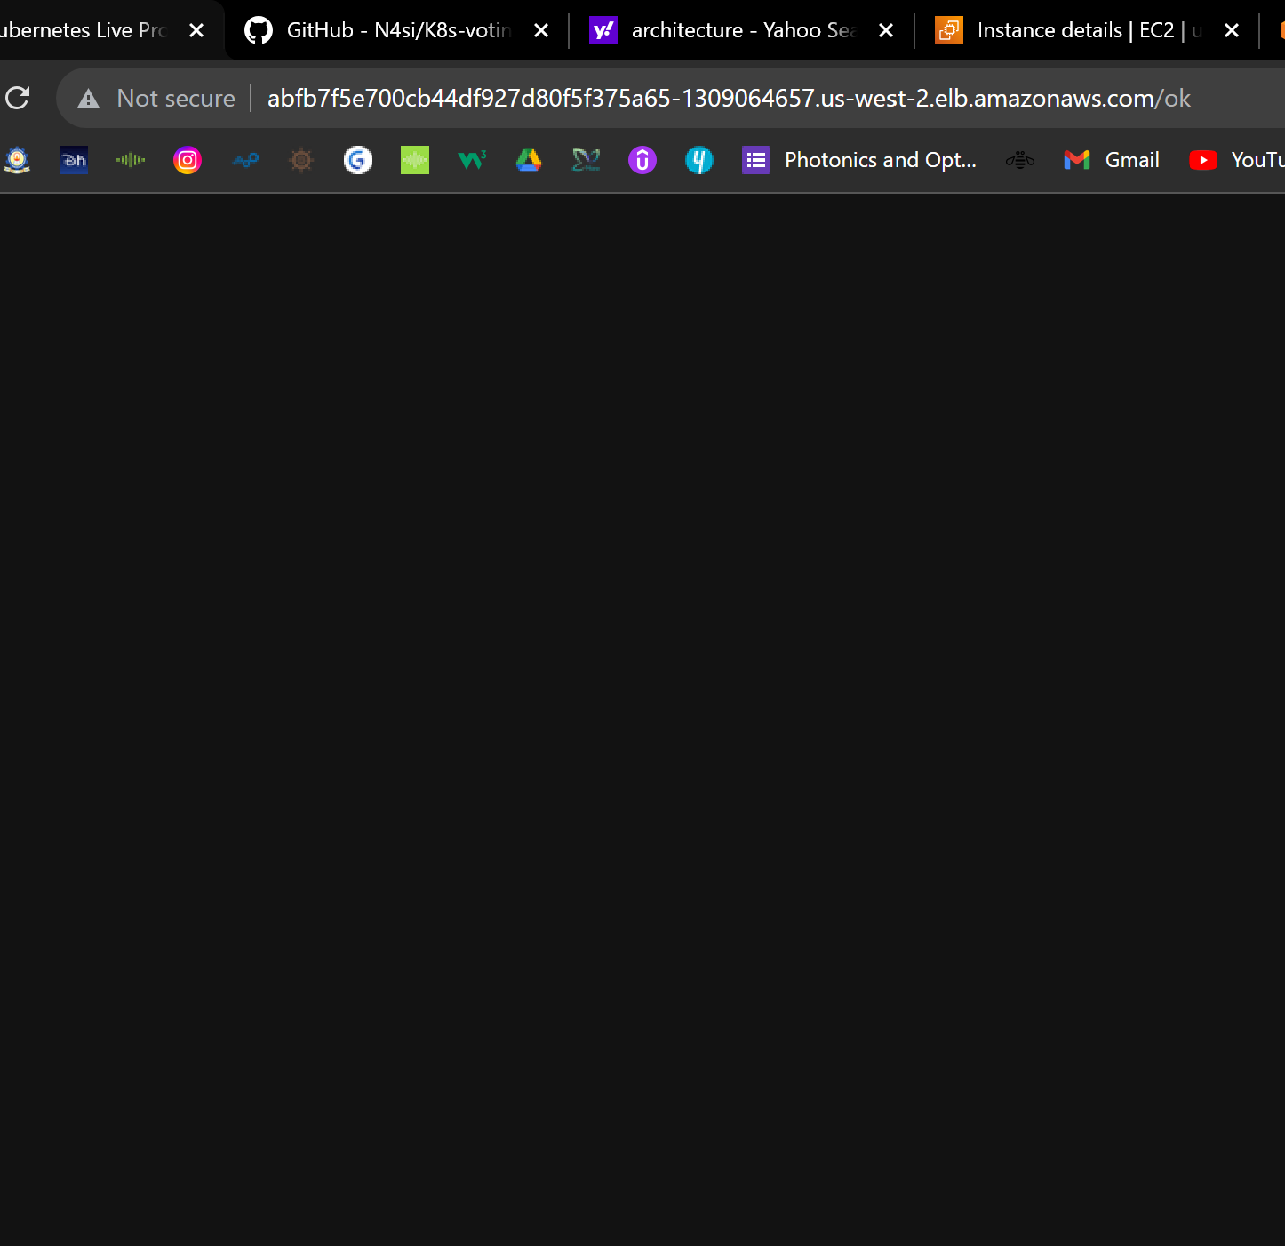

API Verification

Slide 12
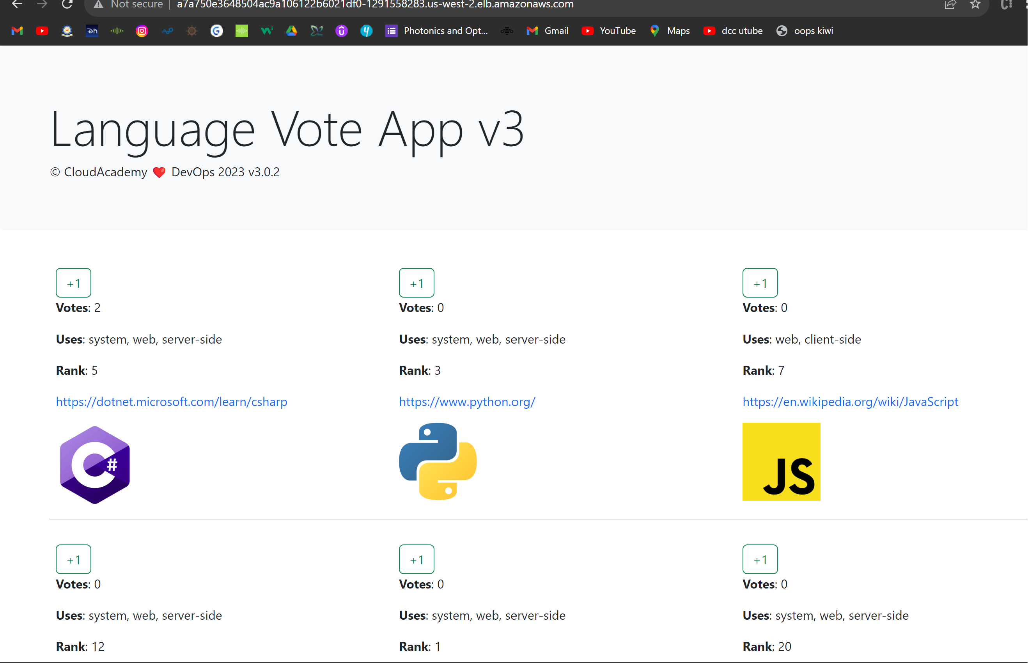
FrontEnd Deployment
From Frontend deployment yaml file contains 2 pods
Now we need to access it to do that we need Load Balancer type to expose it

